Slide 1
Ed Options Review Committee
Update to School Administrators
March 2, 2017
Notes:
Lorna

Slide 2
Objectives
Explain how we got to the work, what work was accomplished, what work still needs to be done.
Dispel a few myths.
Comprehensive Draft of Ed Options - 2/8/17
Ed Options 1-page Overview - 2/8/17
Notes:
Lorna

Slide 3
Agenda
How the committee came to be
The work that has been completed to date
Proposed Values and Purpose
Recommendations and Next steps
Administrator Feedback
Notes:
Lorna

Slide 4
Ed Options Committee Members
Melissa Niiya
Debbie Armendariz
Fred Locke
Sabine Rear
Michael Bacon
Jeanine Fukuda
Oscar Gilson
David Hobbs
Sara King
Carla Gay
Korinna Wolfe
Lorna Fast Buffalo Horse
Amy Kleiner
Sascha Perrins
Kristie Lindholm
Shannon McClure
Meisha Geisler
Judy Brennan
Notes:
Lorna

Slide 5
Pre-assessment
T/F—Educational options in PPS includes alternative schools, focus option schools, day and residential treatment schools, charter schools, dual language immersion programs, community-based alternative schools (CBOs), and other programs.
Notes:
Lorna
Please stand if you believe this statement is true.

Slide 6
Pre-assessment
T/F—Metropolitan Learning Center (MLC) and ACCESS are focus option schools.
Notes:
Lorna
Please stand if you believe this statement is true.

Slide 7
Pre-assessment
T/F—Alliance High School is a CBO Alternative High School.
Notes:
Lorna
Please stand if you believe this statement is true.

Slide 8
Pre-assessment
T/F—Schools like Sunnyside, Creative Science, and da Vinci enroll students who meet the criteria of being a good fit for the stated curriculum and program offered by these schools.
Notes:
Lorna
Please stand if you believe this statement is true.

Slide 9
Pre-assessment
T/F—Benson High School is one of the PPS Educational Options.
Notes:
Lorna
Please stand if you believe this statement is true.

Slide 10
What is the Ed Options Review
A committee of principals and central office staff was formed to review the district’s portfolio of education options. The initial charge was to:
Establish an ongoing process for reviewing educational options including measures of success
Define the desired purpose and goals of education options
Develop recommendations to align the education options system policy and procedures with the Racial Educational Equity Policy
Notes:
Judy

Slide 11
Timeline - Key Events Culminating in the Creation of the Education Options Committee
2004
2008
2011
2013
2014
2015
2016
Education Options Policy created.
Policy states that the district must have a review process for education options.
SACET formed: Superintendent Smith forms Superintendent Advisory Committee on Enrollment & Transfer, a diverse group of community representatives to provide guidance on High School System Design E&T related issues
Racial Educational Equity Policy approved. The policy calls out race-based disparities in schools, identifies the district's role in erasing them and holds up high expectations to ensure that all students reach their academic potential.
DLI expansion plan
Approved by board.
SACET recommendations for K-8 System: issues recommendations related to K-8 system, including recommendation to conduct a “quality review process for focus options”
Superintendent endorses majority of SACET’s recommendations but asks that alternative programs and DLI programs be included in the “education options review”
Education Options Review committee launched conducts initial analysis, including sites visits, and data review of education options; also revises tool and collects “plan of operations” from every Education Option school/program
Education Options Review committee releases draft proposal outlining proposed guiding values and purpose of Education Options
Notes:
Judy

Slide 12
Do you know?
Who are Ed Options?
Notes:
Judy:
If you are a leader of an in-district alternative school, please stand (includes ACCESS & MLC)
If you are a leader of a thematic focus option --not a dual language immersion program, please stand. Includes Benson and Jefferson MC
If you are a leader of a dual language program, please stand
These are leaders of education options that are subject to the ed options review & process.
If you are a leader of a charter school or community-based alternative please stand. These are leaders of educational options that are governed by other review processes.
Collectively, these are your peers who lead education option programs in PPS

Slide 13
Education Options Committee Overview
Initial Charge
Define the desired purpose and goals of education options
Establish an ongoing process for reviewing educational options
  Evaluation process
  Measures of success
Align our work with the racial educational equity policy
Develop recommendations
Included in Scope:
In-District Alternatives
Thematic Focus options
Dual language immersions schools
*Community Based Alternative programs and Charter Schools were not explicitly in the scope of work charged to the Education Options Committee. However, in certain cases, the committee felt it was necessary to include them in analyses in order to provide a more comprehensive picture of the District’s options.
Notes:
Judy

Slide 14
Review Committee Process to Date
Understand current education options system
Develop values to guide Education Option system
Assess current system against these values
Propose desired purpose of Education Options
Develop recommendations and outline future work
  Site visits
  Reviewed individual school “Plans of Operation”
  Reviewed enrollment, achievement and lottery data
  Reviewed previous, related documents (SACET recommendations, Ed Options Policy)
  Identify themes emerging from data
  Create guiding values based on themes
  Review data in light of guiding values
  Identify concerns and opportunities in current system
  Use guiding values and analysis of current system
  Align purpose to Racial Educational Equity Policy
  Outreach across stakeholders
  Provide information and recommendations for other district work and decision-making (e.g. DBRAC)
Notes:
Debbie

Slide 15
Do you know?
What portion of PPS students attend Ed Options?
Notes:
Debbie
Lead in with: “Now that you have seen the proportion of PPS leaders who are at Ed Options…”

Slide 16
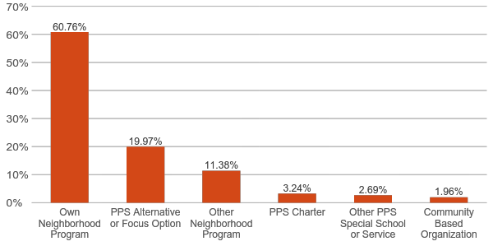
PPS Enrollment by School Type 2015-16
Key Point
Approximately 72% of PPS students attend a neighborhood school
Includes neighborhood schools that students attend outside their assigned attendance boundary
*In this analysis, Alliance, ACCESS, and MLC are included as “PPS Alternatives.” PISA, Teen Parent Services and Reconnection Services are included as “Other PPS Special School or Service.” Community based organizations are later shown together with PPS Alternatives on Slide 17.
Notes:
Debbie

Slide 17
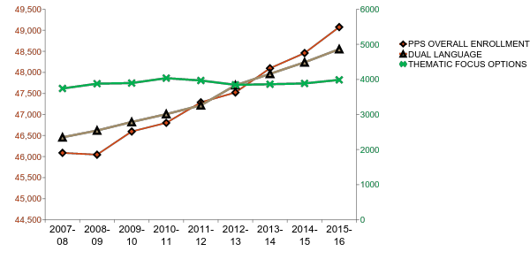
Focus Option Enrollment
PPS OVERALL ENROLLMENT
FOCUS OPTIONS & DUAL LANGUAGE
Notes:
Debbie: Thematic focus option enrollment has remained stable while DLI and overall PPS enrollment has grown.

Slide 18
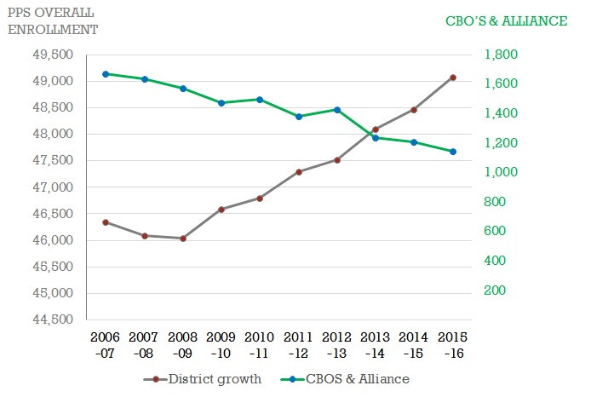
Alternative Enrollment
Notes:
Debbie: Thematic focus option enrollment has remained stable while DLI and overall PPS enrollment has grown.
Meanwhile, alternative ed enrollment has decreased.

Slide 19
Education Options Committee -
Work to Date
What it does do?
What it doesn’t do?
Values to guide future planning for creation, modification, or possible closure of specific education option programs/schools
A framework for the development of a fair, equitable and transparent evaluation process of education options
A outline of systemic trends that should help guide location decisions in the future
An articulation of specific value that education options should bring to the PPS system
Evaluation/assessment of individual education option programs or schools
Articulation of which/if specific schools should move, change or expand
Guidance on specific locations for individual schools or programs
Notes:
Korinna

Slide 20
Proposed Values to Guide Education Options
Equity of Access
Evaluation for Effectiveness
Sustainable, Adequate Resources and Operations
Healthy Ecosystem of Schools
Notes:
Korina presents overview.
Principals each take one. You could also mention the challenges with each one. Those are on slides 29-31
Lorna, Equity of Access
Kristie, Evaluation for Effectiveness
Fred, Sustainable, Adaquate Resouces and Operations
Amy, Healthy Ecosysstem of Schools
Glennon - Turn this into five slides

Slide 21
Proposed Values to Guide Education Options
Equity of Access
  Eliminate the predictability and disproportionality of which student groups apply to, enroll in, and succeed in education options
Notes:
Lorna, Equity of Access

Slide 22
Proposed Values to Guide Education Options
Evaluation for Effectiveness
  Evaluate for effectiveness, including: that they attract and effectively serve the students they intend to serve; that promising practices from these schools are being shared, and to the degree possible, replicated in neighborhood schools; and that they contribute toward closing opportunity gaps for historically underserved students
Notes:
Kristie, Evaluation for Effectiveness

Slide 23
Proposed Values to Guide Education Options
Sustainable, Adequate Resources and Operations
  Clear understanding of what resources are required to sustain education options over time
  Adequate resources--such as teaching staff, building and location, transportation, and wrap around services provided in ways that support the purpose of each option
Notes:
Fred, Sustainable, Adequate Resources and Operations

Slide 24
Proposed Values to Guide Education Options
Healthy Ecosystem of Schools
  Education options as a desired destination in a context of a strong foundation of neighborhood schools
  Education options support the District’s aim to create right-sized, right-resourced programs
Notes:
Amy, Healthy Ecosystem of Schools

Slide 25
Who: Specific populations of students PPS did not serve well; individualized, flexible and strategic supports not offered at comprehensive/neighborhood programs
How: wrap-around supports and intensive academic support; will require more resources to sustain than other schools. Meets alternative education statute.
PROPOSED: Education Options Purpose
Education Options can serve multiple
purposes.
Personalized, Strategic Supports
Who: Typically, student population is representative of the overall district population or at least representative of surrounding neighborhoods
How: Program/curriculum is different than what is currently offered at neighborhood schools. Program could one day be replicated in neighborhood schools. Ongoing and consistent evaluation of the program
determines effectiveness and whether it should be replicated.
Who: Specific populations depending on the research aim of the program.
How: Themes/curricular foci selected based on districtwide interest and demonstrated effectiveness at closing opportunity gaps. Due to logistical or financial constraints, the program may not be replicated districtwide.
Incubating Practices
Specific Curricular Focus
Notes:
Amy

Slide 26
Do you know?
What populations are represented at education options?
Notes:
Judy

Slide 27
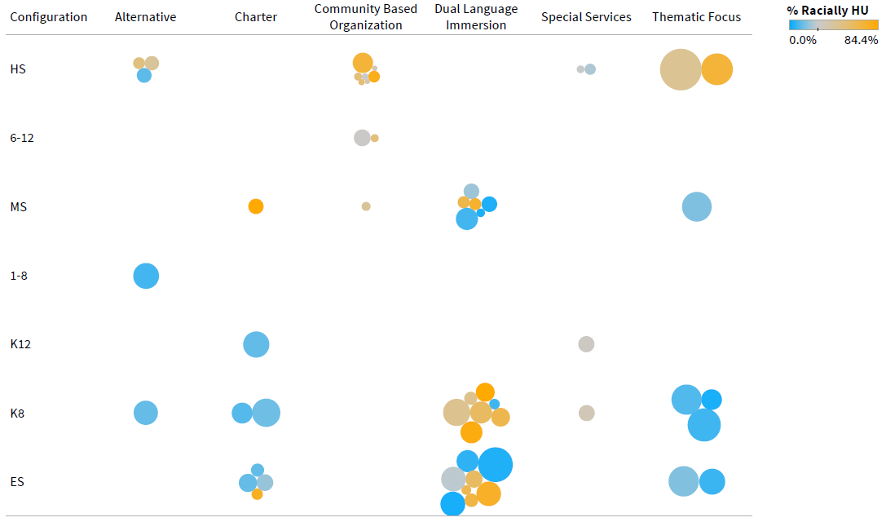
2015-16 District average:
28%
Notes:
Judy
Name the races in HU: African-American, Latino, Pacific Islander, American

Slide 28
Key Recommendations
Highest priority is addressing Alliance facility needs
Next most urgent need is review of co-located DLI programs and focus options that will be impacted by upcoming enrollment balancing (DBRAC) work
Additional priorities include establishing central supports and looking at admission procedures, updating policies, etc.
Notes:
Fred: A list of all recommendations is on the one-page overview. Here are key priorities

Slide 29
Next Steps
Communicate findings and recommendations to key stakeholders including school administrators, PAPSA, teachers, PAT, families, schools, the PPS Board, and DBRAC (District-wide Boundary Review Advisory Committee).
Assign department or committee responsible for implementation of recommendations
Re-charter Education Options Review Committee, including naming an administrator and Executive Sponsor and revisiting membership based on next phase of work/priorities.
Define timeline for first round of evaluations and communicate timeline to schools and families. Stay informed by visiting the PPS website and your school’s website.
Notes:
Kristie

Slide 30
Please Provide Feedback
Link to survey
Notes:
Kristie

